Slide 1
TOPIC C:
CASE STUDY
LESSON C-8
CHALLENGES FACED

Slide 2
AGENDA
Short vocab quiz
Technical Challenges
Operational Challenges
Human & Cultural Challenges
Regulatory, Legal, Compliance Challenges
NOTE!
Have a way to take notes and a way to write code available for this lesson

Slide 3
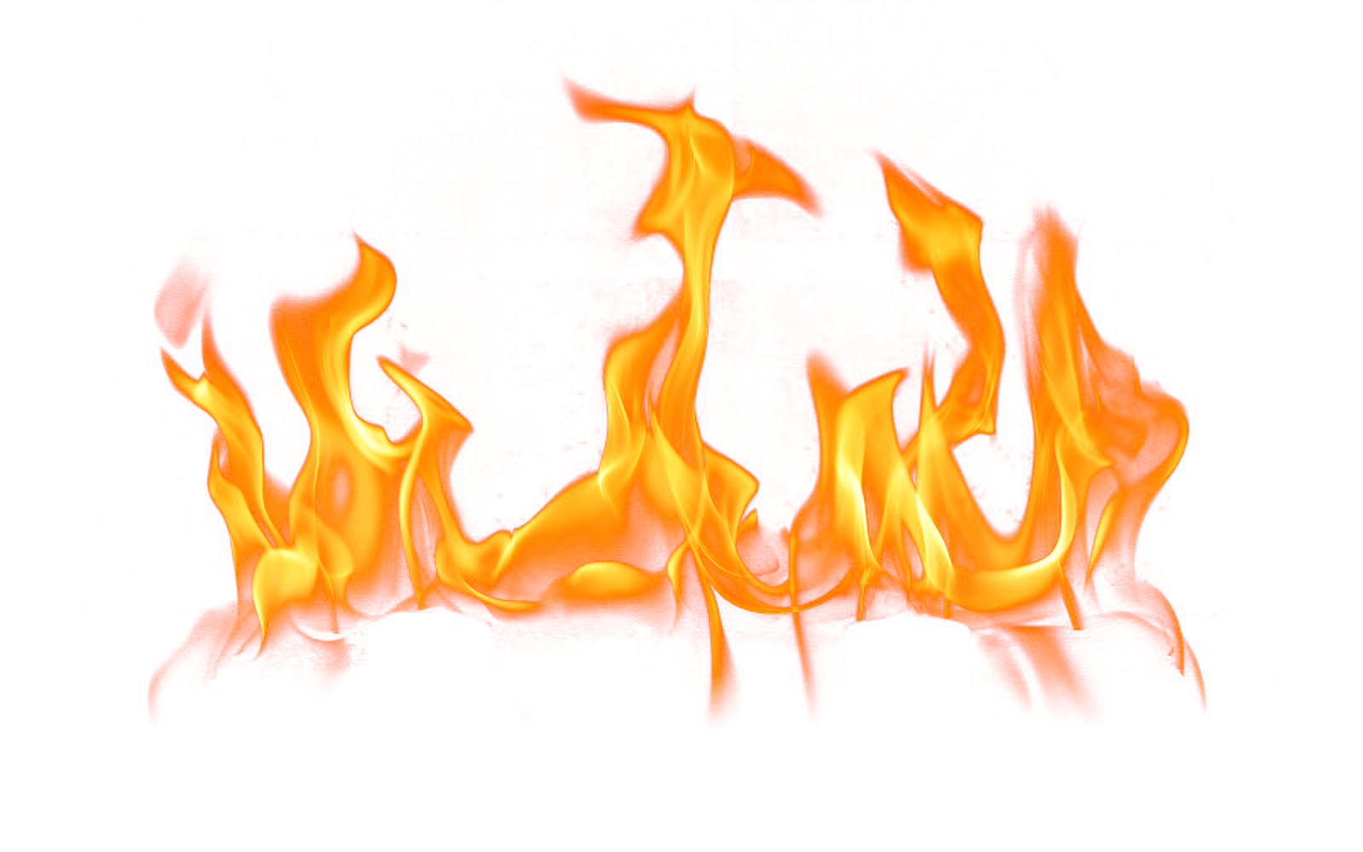
THE WARM UP QUIZ?!?!?!?!?
QUIZ TIME

Slide 4
WHY IS TESTING A HOSPITAL DIFFERENT?
What makes cybersecurity testing so difficult in a healthcare environment?

Slide 5
WHY IS TESTING A HOSPITAL DIFFERENT?
Systems must stay online
Patient safety is high stakes
Legacy devices may be old or outdated
Lots of regulation
Data is very sensitive
Budget might not be very large
These pressures create real challenges, even when we perfectly follow PTES

Slide 6
TECHNICAL CHALLENGES
What might be some technical challenges that we’d see in the hospital?

Slide 7
TECHNICAL CHALLENGES
Some challenges:
Hospitals often rely on old, unsupported machines (legacy MRI controllers, Windows 7 computers)
Internet of Things medical devices often use proprietary or non-standard protocols
Some systems cannot be rebooted or tested aggressively as patients rely on them 24/7
Updating software is difficult because downtime disrupts care

Slide 8
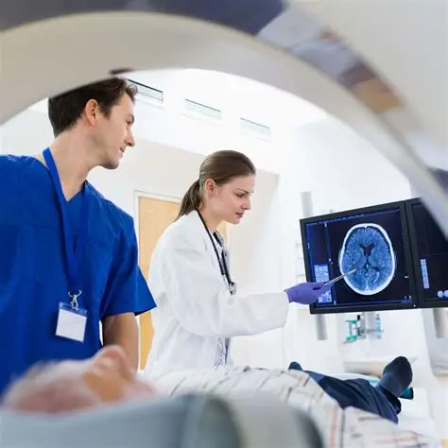
TECHNICAL CHALLENGES
Example:
A radiology server can’t be restarted for updates because it would push back patient scans

Slide 9
TECHNICAL CHALLENGES
What this means for us:
Limits what tools we can use during scanning and exploitation
Heavy reliance on simulations
What might be a problem in this situation?
Increased risks of unintended disruptions

Slide 10
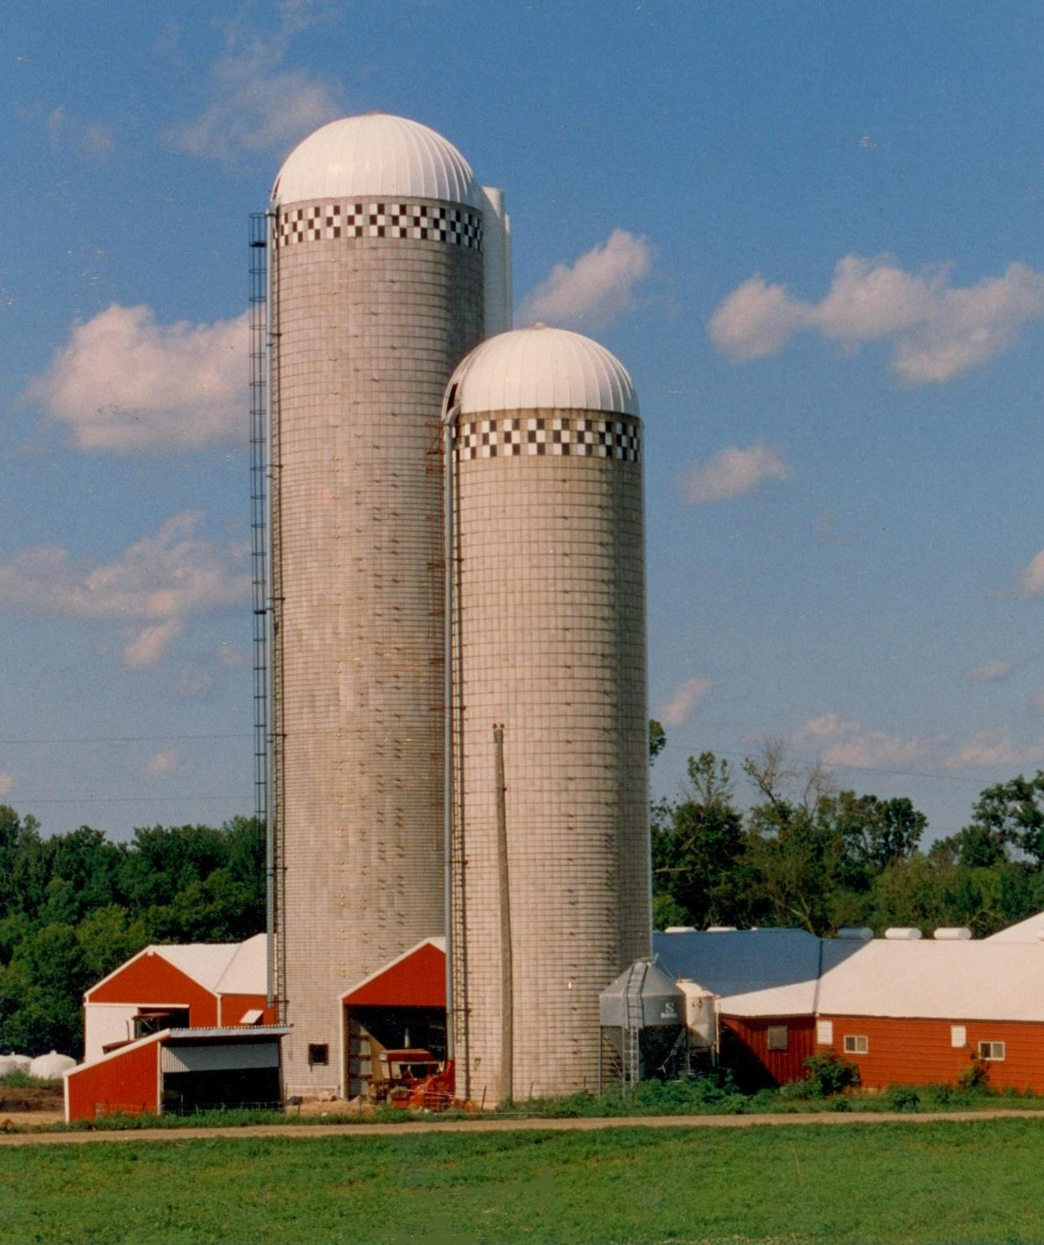
OPERATIONAL CHALLENGES
Hospitals are always in operation, no time to test after hours
When hospitals aren’t in operation, the windows are generally tiny and at night
Staff are often overworked and not trained well enough (technology wise)
Departments may be ‘siloed’ – meaning that the hospital’s IT might be spread between departments

Slide 11
OPERATIONAL CHALLENGES
Example: the only good time to test is between 1-3AM on Sundays
This limits scan depth as well as being inconvenient

Slide 12
OPERATIONAL CHALLENGES
What this means for us:
In phase 1 (pre-engagement interactions) we must negotiate schedules with the hospital
Intelligence gathering and exploitation must minimize network traffic
Reporting must be realistic about our knowledge of the hospital’s constraints

Slide 13
HUMAN & CULTURAL CHALLENGES
Challenges:
Doctors & nurses often see security as a barrier, not a priority
People may resist security protocols that slow them down (password policies, MFA)
Staff may engage in unsafe shortcuts (sharing logins, sticky notes with passwords on them)
Social engineering risk is high because healthcare workers are trained to be helpful

Slide 14
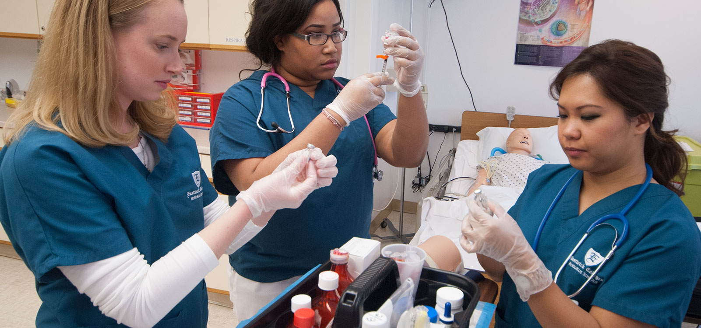
HUMAN & CULTURAL CHALLENGES
Example: a nurse quickly shares their login with a trainee “just to get through the morning rounds”

Slide 15

HUMAN & CULTURAL CHALLENGES
What this means for us:
Threat modelling must account for insider mistakes
Post-exploitation risk assessment must consider human error risks
Reporting must include recommendations for workplace culture changes

Slide 16
REGULATORY, LEGAL, & COMPLIANCE CHALLENGES
Hospitals are legally required to protect Personal Health Information (PHI) under HIPPA
Testing must be extremely well documented to avoid liability
Any disruption to medical services we can be sued for
Vendors of machines may not allow third party probing of their devices

Slide 17
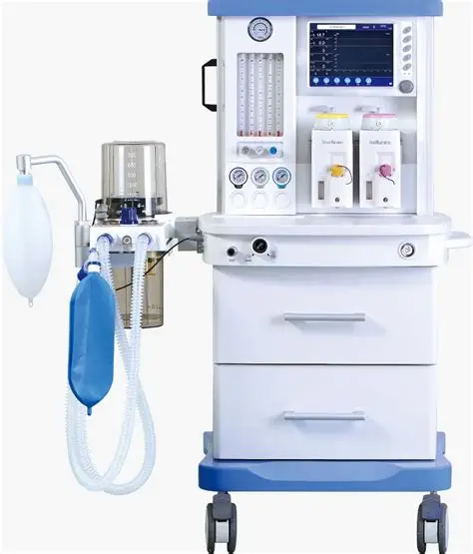
REGULATORY, LEGAL, & COMPLIANCE CHALLENGES
Example:
A vendor refuses to allow CyberHealth Security to scan an anesthesia machine, limiting the coverage of our network scan

Slide 18

REGULATORY, LEGAL, & COMPLIANCE CHALLENGES
What this means for us:
Pre-engagement contracts must reflect legal boundaries
Evidence gathering is somewhat restricted
Reports must be carefully phrased and contain no PHI

Slide 19
HUMAN & CULTURAL CHALLENGES
What this means for us:
Threat modelling must account for insider mistakes
Post-exploitation risk assessment must consider human error risks
Reporting must include recommendations for workplace culture changes

Slide 20
CHALLENGE ANALYSIS MATRIX
Pick one of the following difficulties and write down a challenge analysis matrix
No, you cannot just say it out loud
Legacy systems are in use at the hospital
Staff is resistant to using MFA
Testing windows are very limited at the hospital
Fill in the following info about the challenge
Why it occurs, how it affects PTES phases, risk to hospital, possible mitigation strategies

Slide 21
STRATEGIC RESPONSES
Because we cannot fully eliminate challenges, only manage them, we may implement some of the following common strategies for hospitals:
Zero Trust Architectures
Don’t trust any person at the hospital with everything, and have as much accountability as possible
Regular Patch Cycles
On a regular basis, check software for updates and patch them

Slide 22
STRATEGIC RESPONSES
Network Segmentation
Create virtual networks for different divisions of the hospital
Separate admin, tech, and emergency systems
Vendor Risk Assessments
Any technologies that the hospital purchases must be assessed for how risky it may be
Staff Training
Phishing simulations and other trainings

Slide 23
PTES’ ROLE
The PTES in and of itself helps to mitigate some of these challenges as well
Ensures safety
Reporting drives change
Threat modelling prioritizes resources
Post-exploitation reveals hidden risks

Slide 24
WS C-2
Worksheet C-2 is up on Github, and this one’s a helpful one
The questions are in the same style as the DP exam questions from the case studies in previous years
Take care to try your best to answer these
If you’re struggling with being able to answer them, come talk to me

